Slide 1
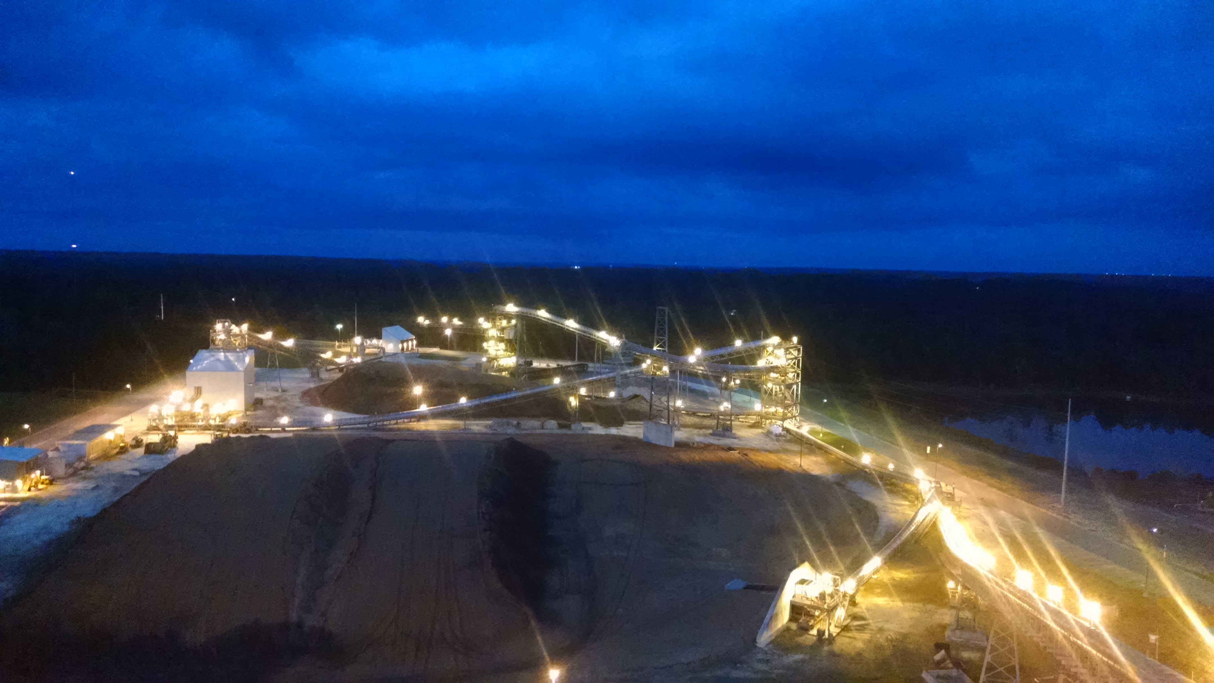
GREC Environmental

Slide 2
Permits
Title V Air
NPDES MSGP Stormwater
SRWMD Groundwater Use
COC
NTNC Potable Well Water
AST

Slide 3
Compliance
(0) NOVs – CWOE & CAO resolution
MSGP DMRs Year 2 – Below cut-off concentrations, Year 4 analytical waiver
(0) Hazardous Spills
(6) Non-reportable oil spills, site documentation
(1) Reported wastewater (process) spill

Slide 4
RATA March 2017

Slide 5
Compliance Testing March 2017

Slide 6
CEMS
Hardware – Trace Environmental, CAI Analyzers
DAHS – Upgraded to VIM Technologies in 2014
CEMSolutions – Monthly/Quarterly Maintenance and QA/QC, RATA/Compliance

Slide 7
Inspections
ACEPD & FDEP
Air, potable & stormwater, hazardous chemicals, tanks
Initial & Subsequent periodicities
GREC in full compliance; minor observations remedied and approved by Agencies

Slide 8
Odor Control – Atomization

Slide 9
Odor Control – Activated Carbon

Slide 10
Fugitive Dust Mitigation
Water Bosses, Speed Bump, Wind Socks & Weather Stations (2013)
Additional Tree Buffer & Lignin Application (2014)
ACPW Particulate Monitoring (2015)

Slide 11
Lignin Injection

Slide 12
Noise Attenuation - December 2013

Slide 13
Noise Attenuation – Stack Liner

Slide 14
Noise Attenuation - Other
Truck Tipper & Hog House Dust Suppression – Filter Collector Discharge/Exhaust re-positioned to the SE
Acoustic panels installed on Hog Bins
Heavy Equipment back-up audible alarms replaced with white noise

